Slide 1
Web Application Development With Java CEJV 559
Git

Slide 2
Git History
Came out of Linux development community
Linus Torvalds, 2005
Initial goals:
Speed
Support for non-linear development (thousands of parallel branches)
Fully distributed
Able to handle large projects like Linux efficiently
Notes:
Initial goals were to support development of Linux

Slide 3

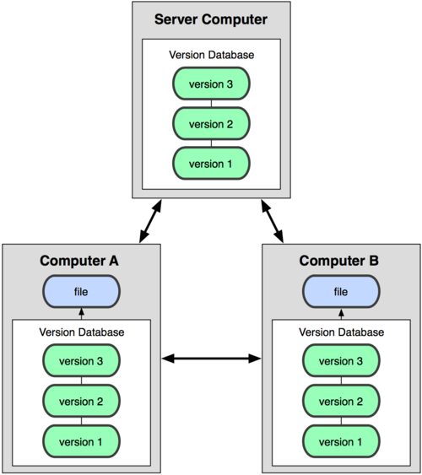
Git uses a distributed model
Centralized Model
Distributed Model
(CVS, Subversion, Perforce)
(Git, Mercurial)
Result: Many operations are local
Notes:
http://git-scm.com/book/en/Getting-Started-About-Version-Control

Slide 4
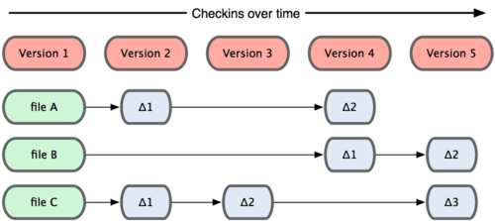
Subversion Stores Changes (Delta)

Slide 5
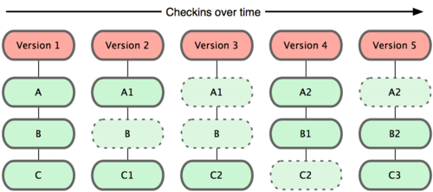
Git takes snapshots

Slide 6
Git uses checksums
In Subversion each modification to the central repo incremented the version # of the overall repo.
Git generates a unique SHA-1 hash – 40 character string of hex digits, for every commit.
Refer to commits by this ID rather than a version number.
Often we only see the first 7 characters:
1677b2d Edited first line of readme
258efa7 Added line to readme
0e52da7 Initial commit

Slide 7

A Local Git project has three areas
Unmodified/modified Files
Staged Files
Committed Files
Note: working directory sometimes called the “working tree”, staging area sometimes called the “index”.

Slide 8
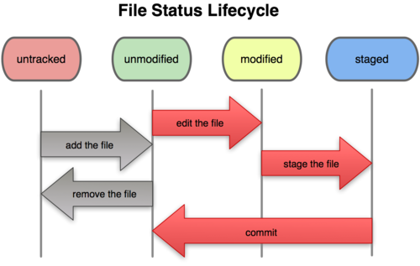
Git file lifecycle

Slide 9
Basic Workflow
Basic Git workflow:
Modify files in your working directory.
Stage files, adding snapshots of them to your staging area.
Do a commit, which takes the files as they are in the staging area and stores that snapshot permanently to your Git directory.

Slide 10
Basic Workflow
If a particular version of a file is in the git directory, it’s considered committed.
If it’s modified but has been added to the staging area, it is staged.
If it was changed since it was checked out but has not been staged, it is modified.

Slide 11
Git commands
command | description
git clone url [dir] | copy a git repository so you can add to it
git add files | adds file contents to the staging area
git commit | records a snapshot of the staging area
git status | view the status of your files in the working directory and staging area
git diff | shows diff of what is staged and what is modified but unstaged
git help [command] | get help info about a particular command
git pull | fetch from a remote repo and try to merge into the current branch
git push | push your new branches and data to a remote repository
others: init, reset, branch, checkout, merge, log, tag

Slide 12
Committing files
First time a file is tracked, and every time before a commit it must added to the staging area
This takes a snapshot of these files at this point in time and adds it to the staging area.
To move staged changes into the repo we commit
To unstage/undo a change on a file before committing it use revert (reset)
To unmodify a modified file you checkout
These commands are just acting on your local version of repo.

Slide 13
Pulling and Pushing
Good practice:
Add and Commit your changes to your local repo
Pull from remote repo to get most recent changes (fix conflicts if necessary, add and commit them to your local repo)
Push your changes to the remote repo
Notes:
$ git remote -v
origin https://github.com/rea2000/santalist.git (fetch)
origin https://github.com/rea2000/santalist.git (push)

Slide 14
Pulling and Pushing
To fetch the most recent updates from the remote repo into your local repo, and put them into your working directory you pull
To push your changes from your local repo to the remote repo you push

Slide 15
Why is it called Git?
Linus Torvalds has quipped about the name “git“, which is British English slang for a stupid or unpleasant person:
“I’m an egotistical bastard, and I name all my projects after myself. First Linux, now git.”

Slide 16
Bibliography and Resources
Free on-line book: http://git-scm.com/book
Git tutorial: http://schacon.github.com/git/gittutorial.html
Reference page for Git: http://gitref.org/index.html
Git website: http://git-scm.com/
A NetBeans tutorial on Git
https://netbeans.org/kb/docs/ide/git.html

